Slide 1


Fundamentals of Music Processing
Chapter 5: Chord Recognition
Meinard Müller
International Audio Laboratories Erlangen
www.music-processing.de

Slide 2
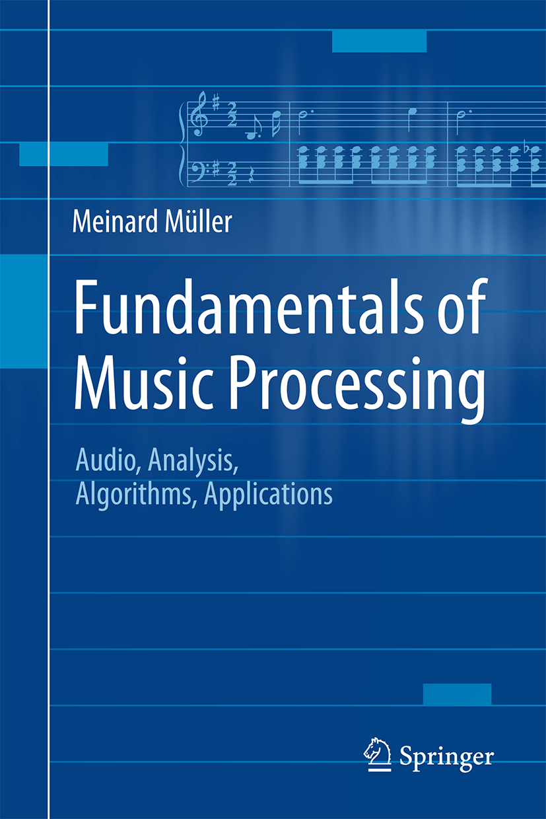

Book: Fundamentals of Music Processing
Meinard Müller
Fundamentals of Music Processing
Audio, Analysis, Algorithms, Applications
483 p., 249 illus., 30 illus. in color, hardcover
ISBN: 978-3-319-21944-8
Springer, 2015
Accompanying website:
www.music-processing.de

Slide 3
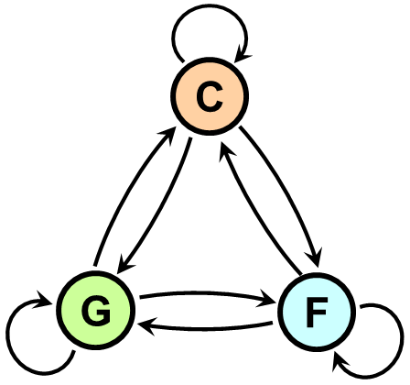
Chapter 5: Chord Recognition
5.1 Basic Theory of Harmony
5.2 Template-Based Chord Recognition
5.3 HMM-Based Chord Recognition
5.4 Further Notes
In Chapter 5, we consider the problem of analyzing harmonic properties of a piece of music by determining a descriptive progression of chords from a given audio recording. We take this opportunity to first discuss some basic theory of harmony including concepts such as intervals, chords, and scales. Then, motivated by the automated chord recognition scenario, we introduce template-based matching procedures and hidden Markov models—a concept of central importance for the analysis of temporal patterns in time-dependent data streams including speech, gestures, and music.

Slide 4
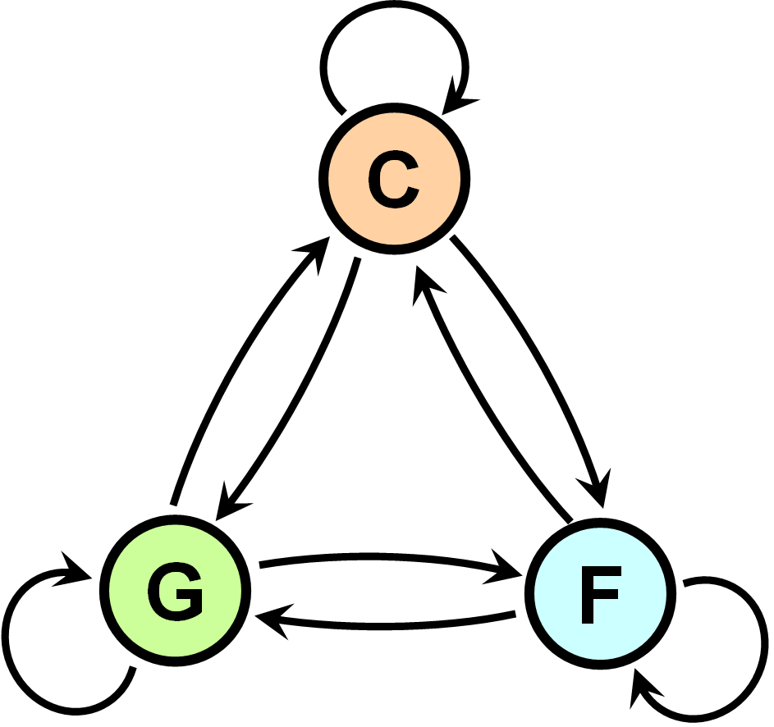
5 Chord Recognition
Teaser

Slide 5
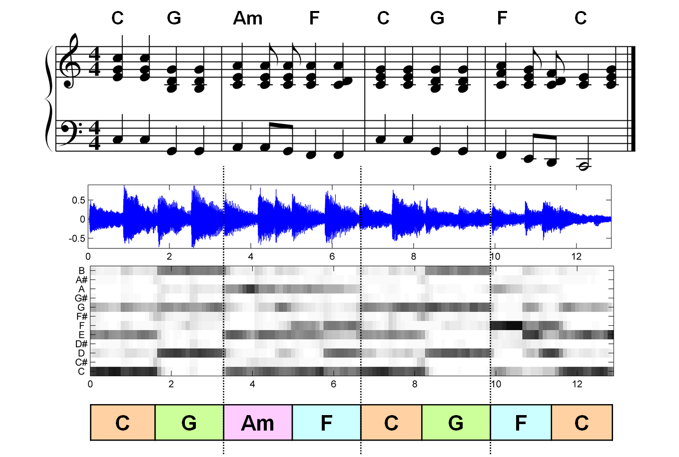
5 Chord Recognition
Fig. 5.1

Slide 6
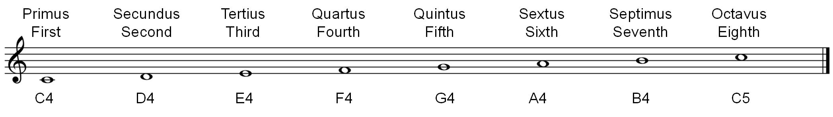
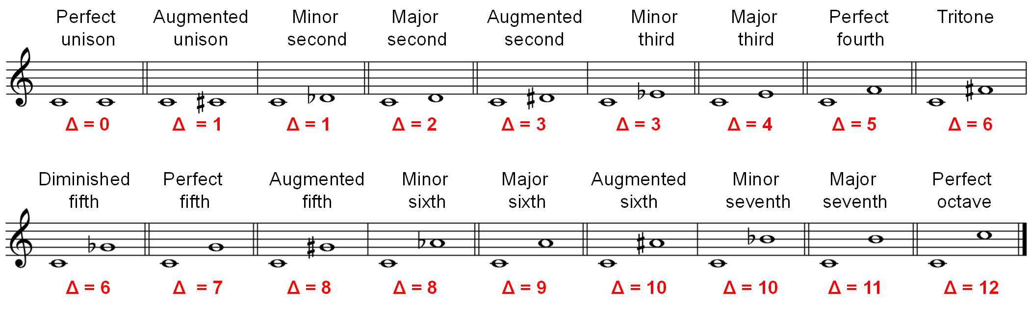
5.1 Basic Theory of Harmony
Fig. 5.2

Slide 7
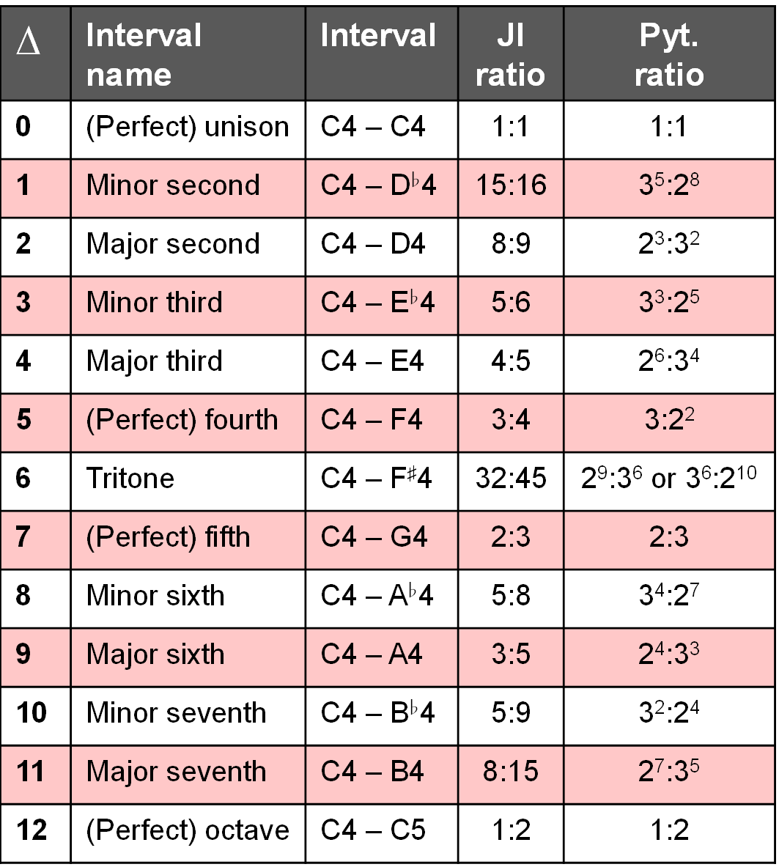
5.1 Basic Theory of Harmony
Fig. 5.3

Slide 8
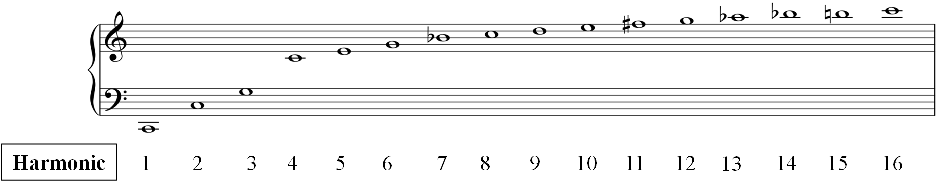
5.1 Basic Theory of Harmony
Fig. 5.4

Slide 9
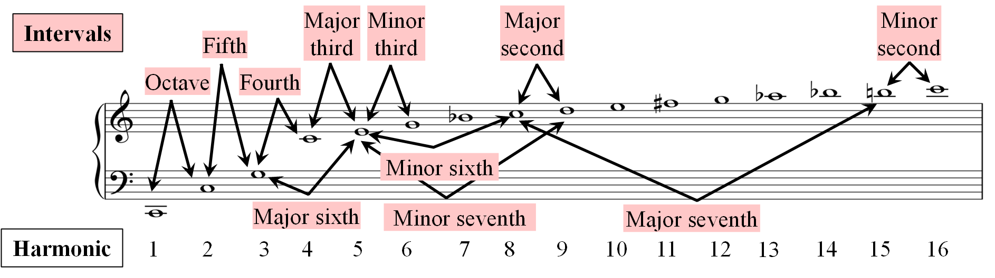
5.1 Basic Theory of Harmony
Fig. 5.4

Slide 10
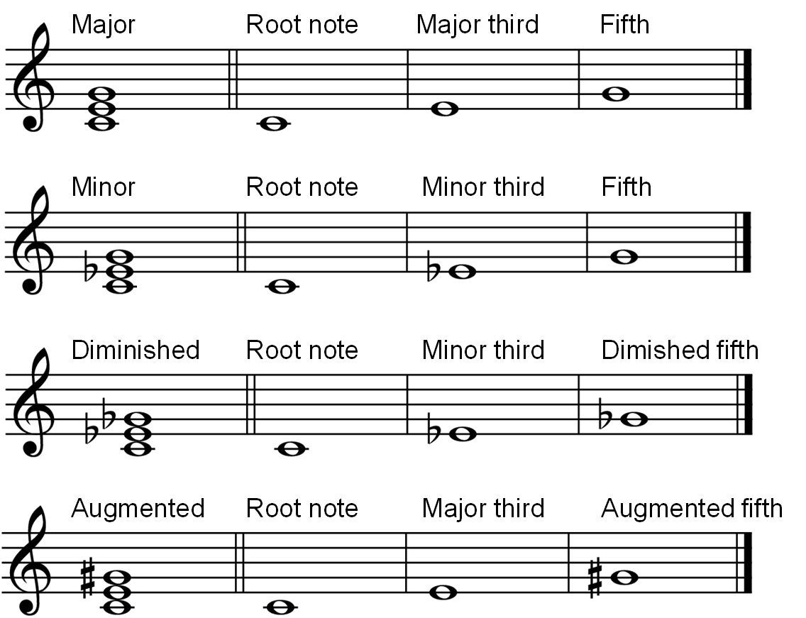
5.1 Basic Theory of Harmony
Fig. 5.5

Slide 11
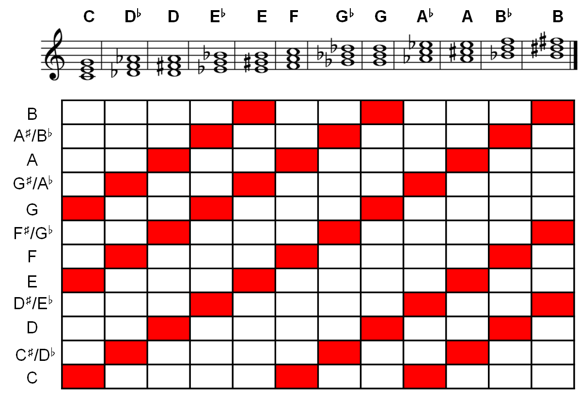
5.1 Basic Theory of Harmony
Fig. 5.6

Slide 12
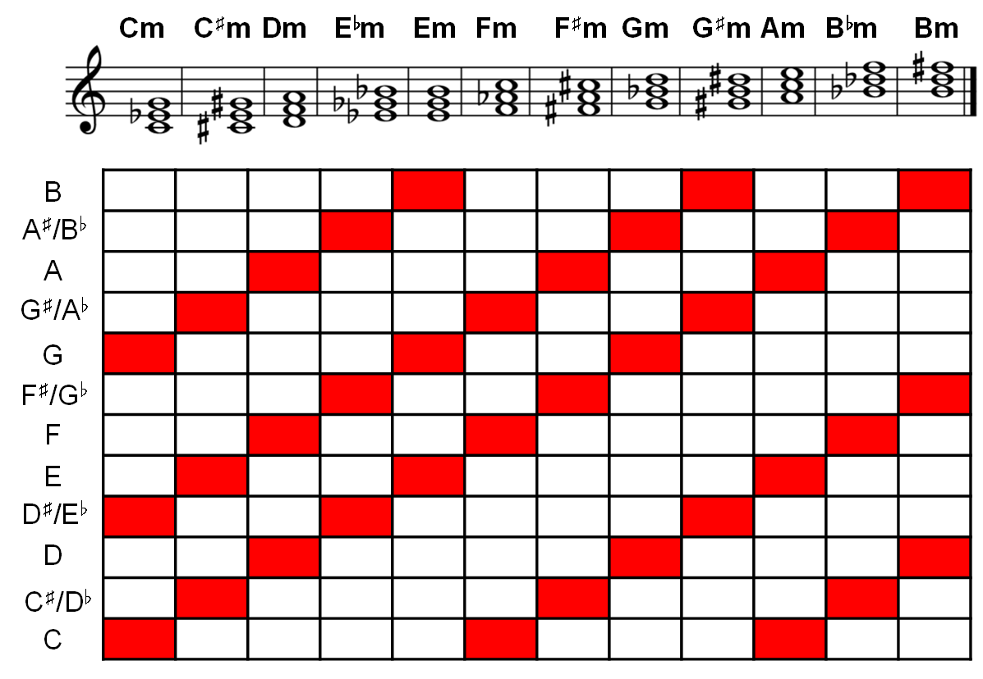
5.1 Basic Theory of Harmony
Fig. 5.6

Slide 13
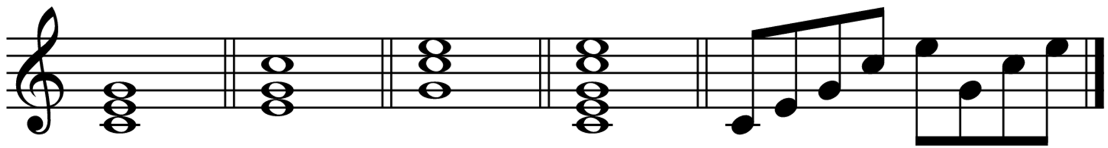
5.1 Basic Theory of Harmony
Fig. 5.7

Slide 14
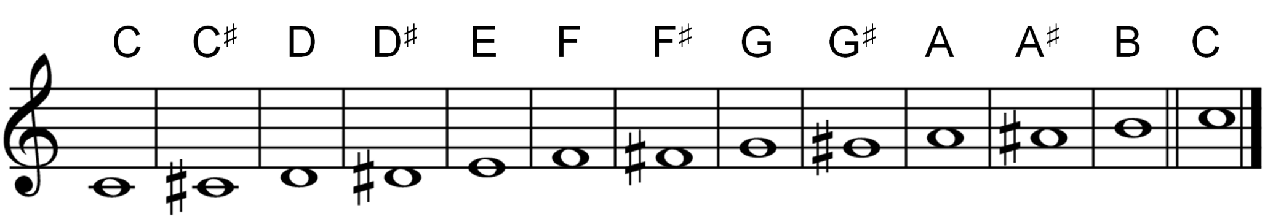
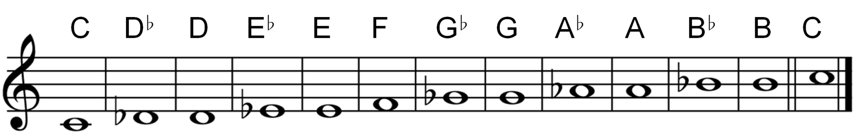
5.1 Basic Theory of Harmony
Fig. 5.8

Slide 15
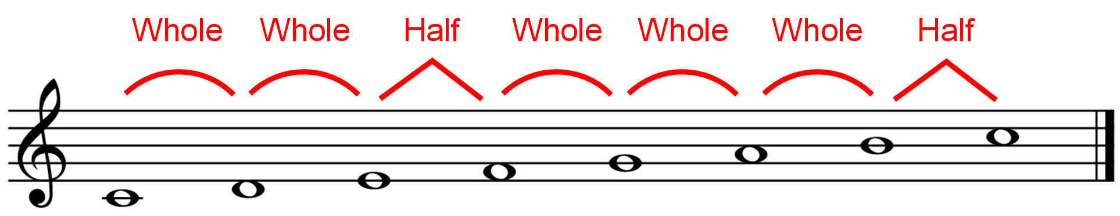
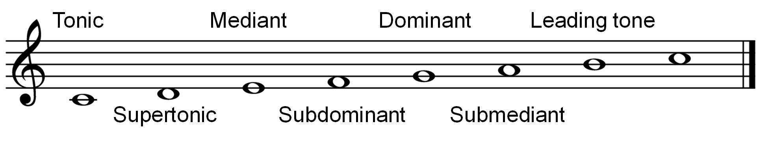
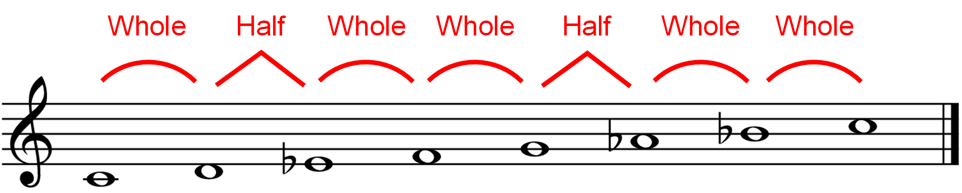
5.1 Basic Theory of Harmony
Fig. 5.9

Slide 16
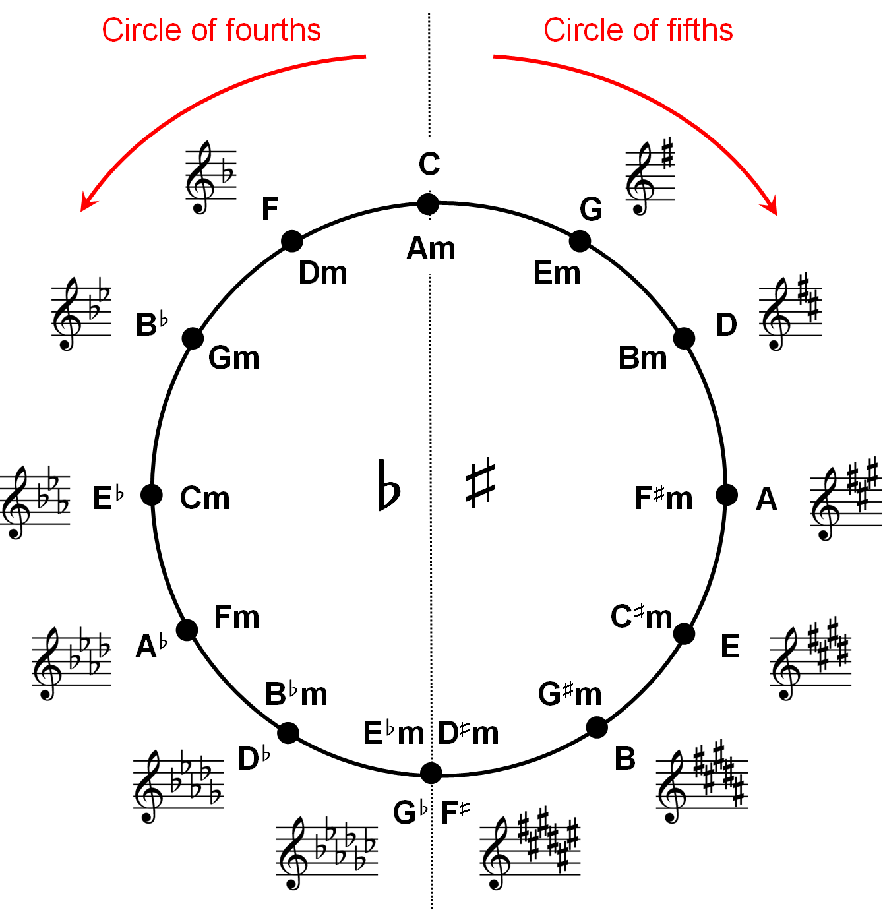
5.1 Basic Theory of Harmony
Fig. 5.10

Slide 17
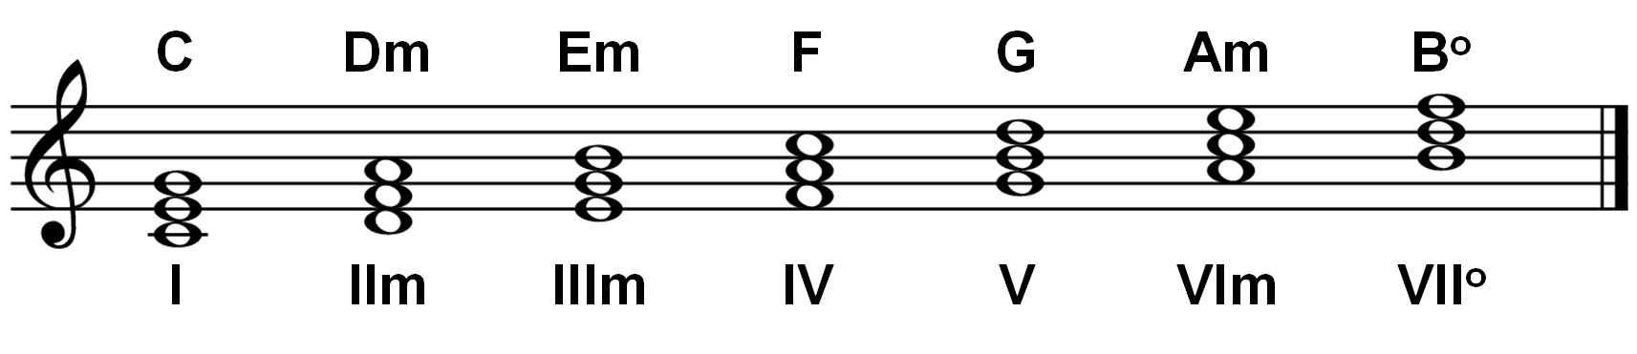
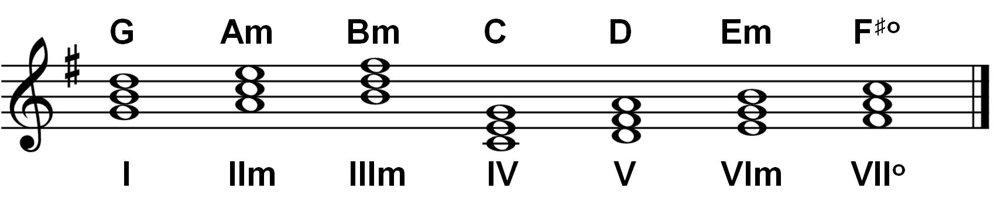
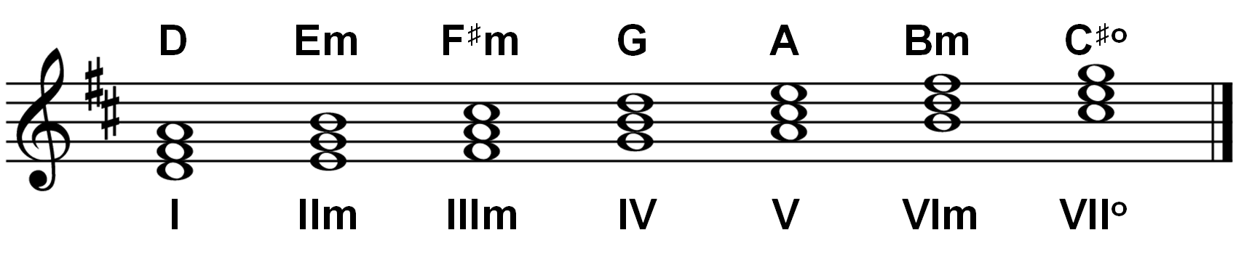
5.1 Basic Theory of Harmony
Fig. 5.11

Slide 18
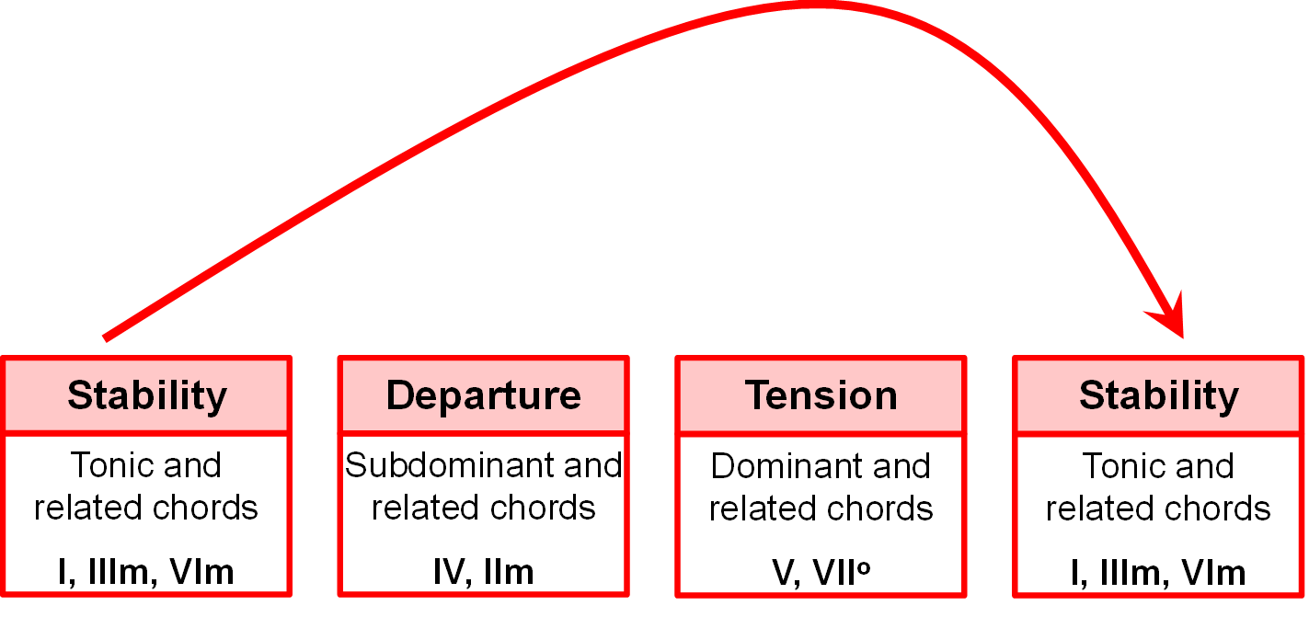
5.1 Basic Theory of Harmony
Fig. 5.12

Slide 19
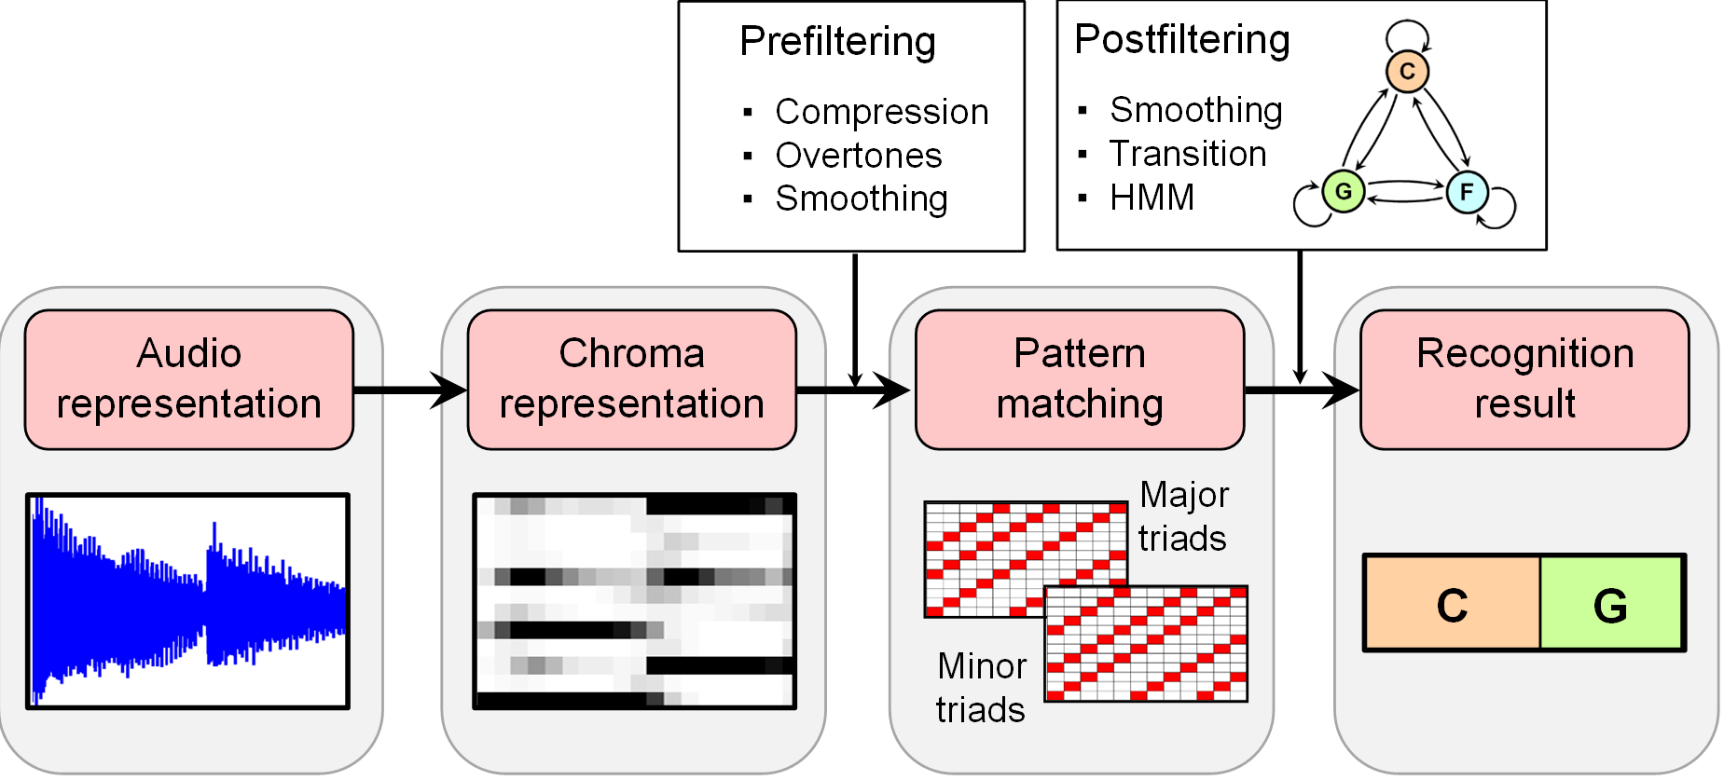
5.2 Template-Based Chord Recognition
Fig. 5.13

Slide 20
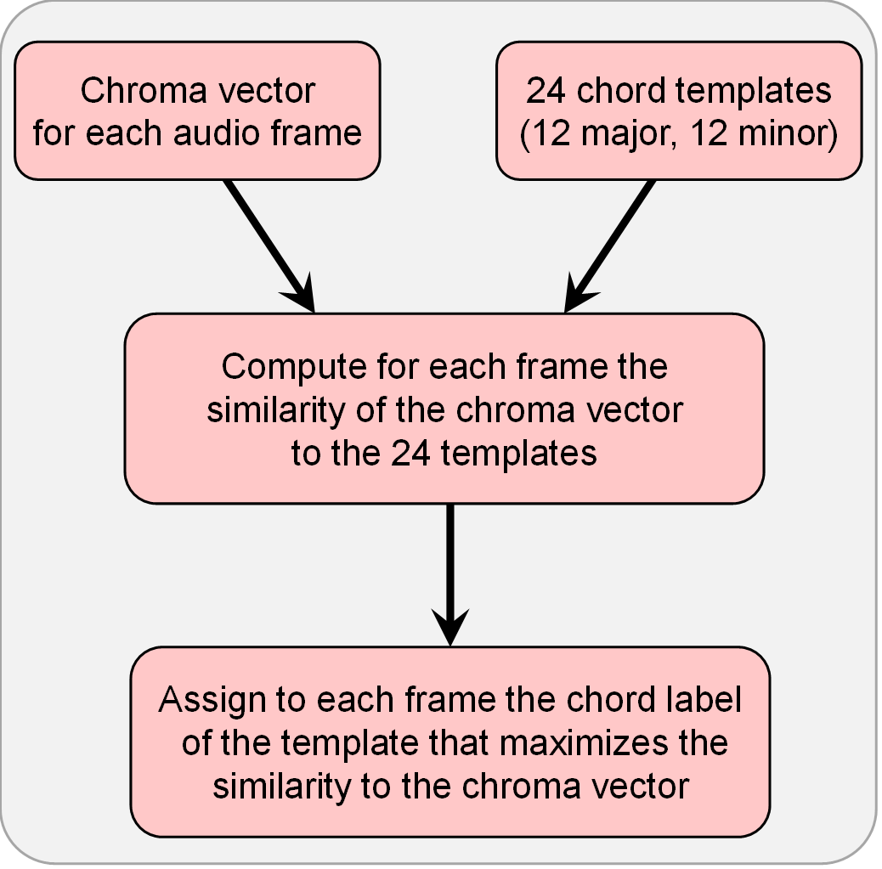
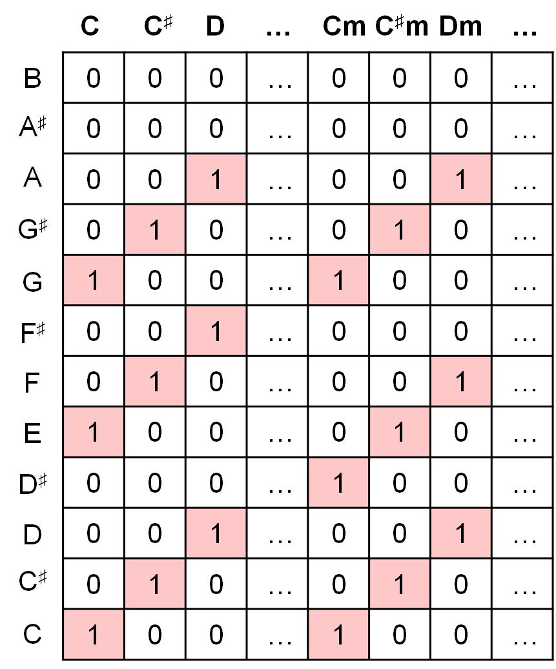
5.2 Template-Based Chord Recognition
Fig. 5.14

Slide 21
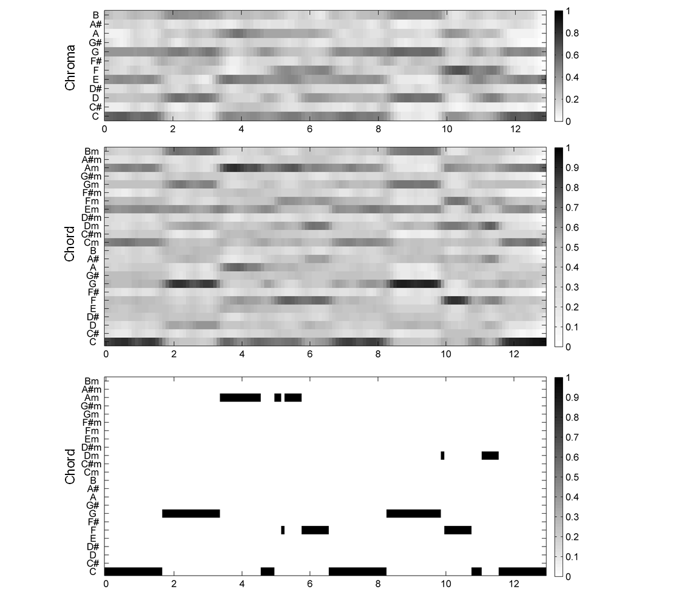
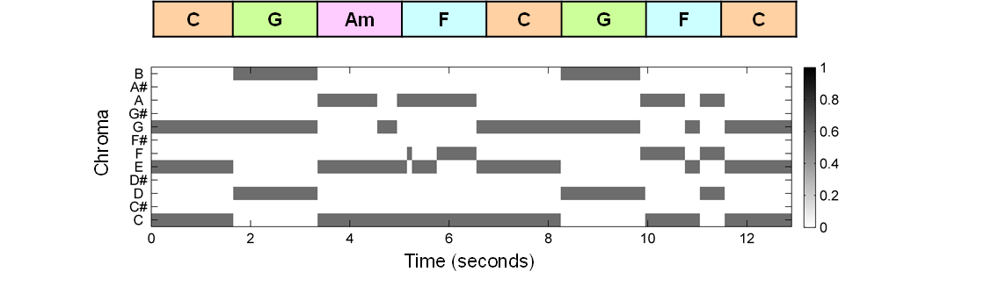
5.2 Template-Based Chord Recognition
Fig. 5.15

Slide 22
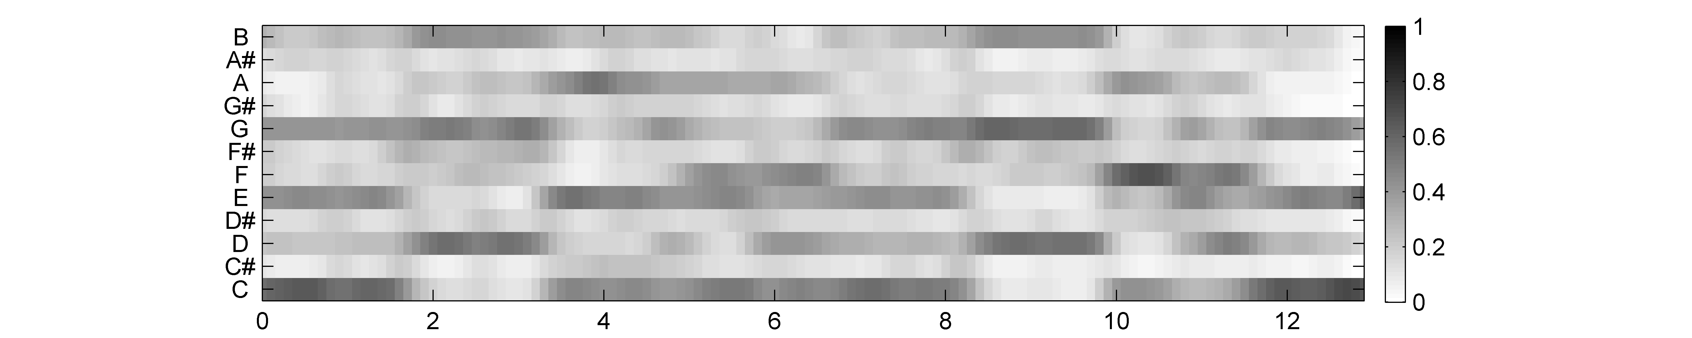
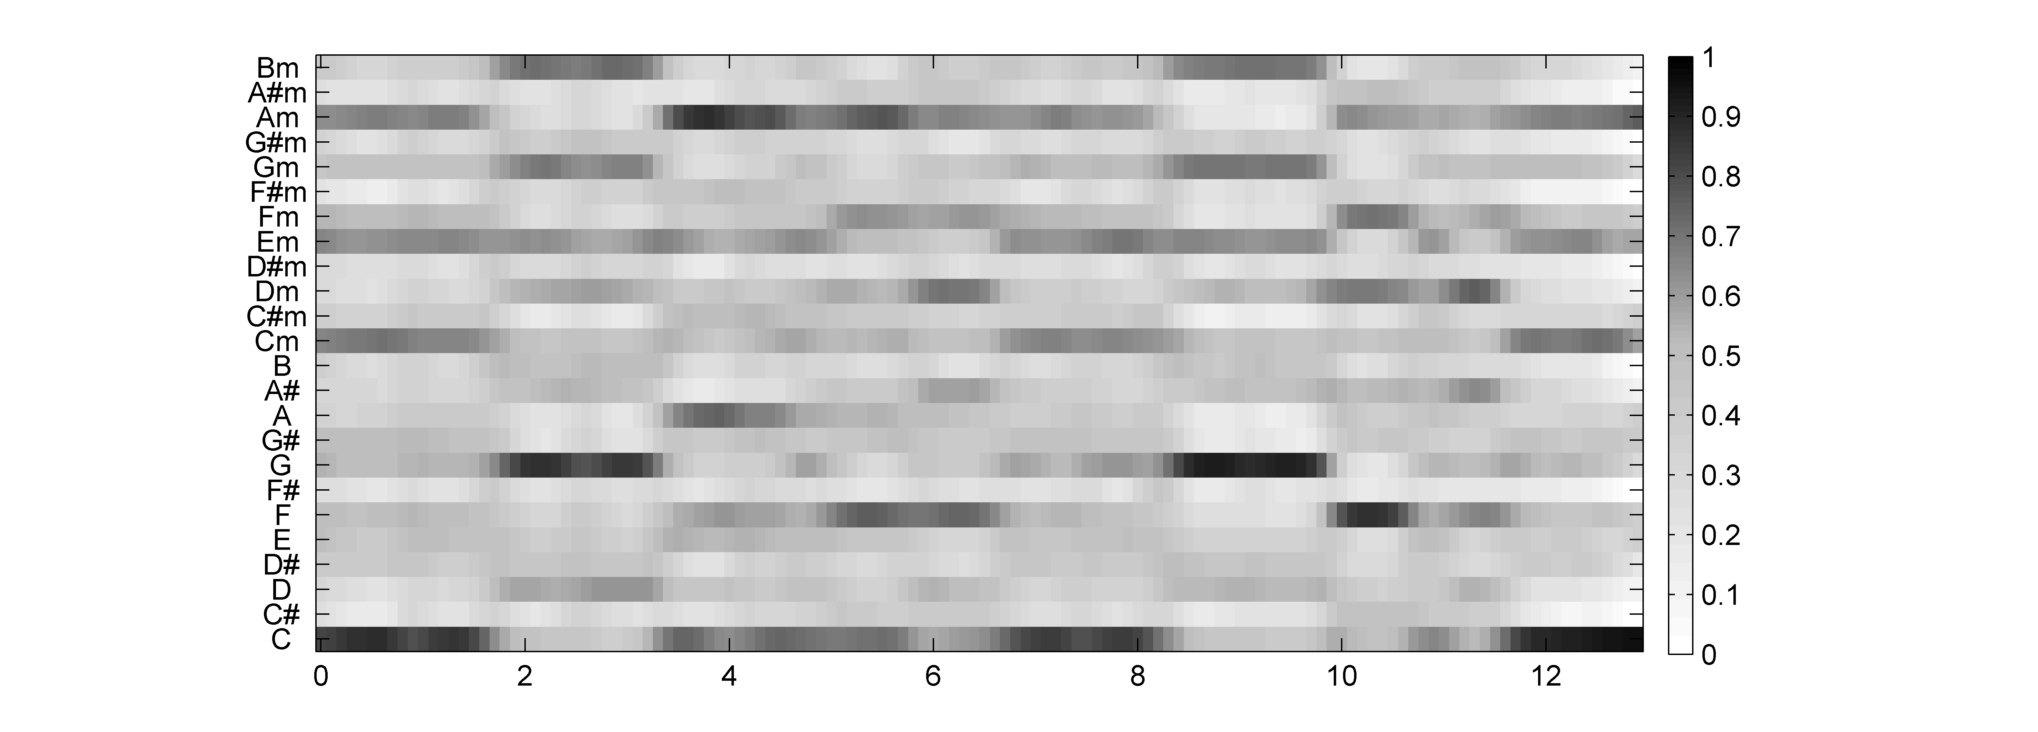
5.2 Template-Based Chord Recognition
Fig. 5.15
Chroma
Chord
Time (seconds)

Slide 23
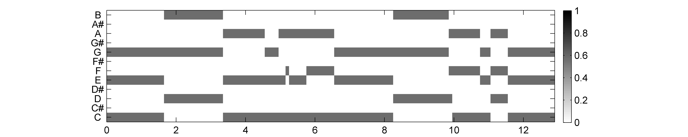
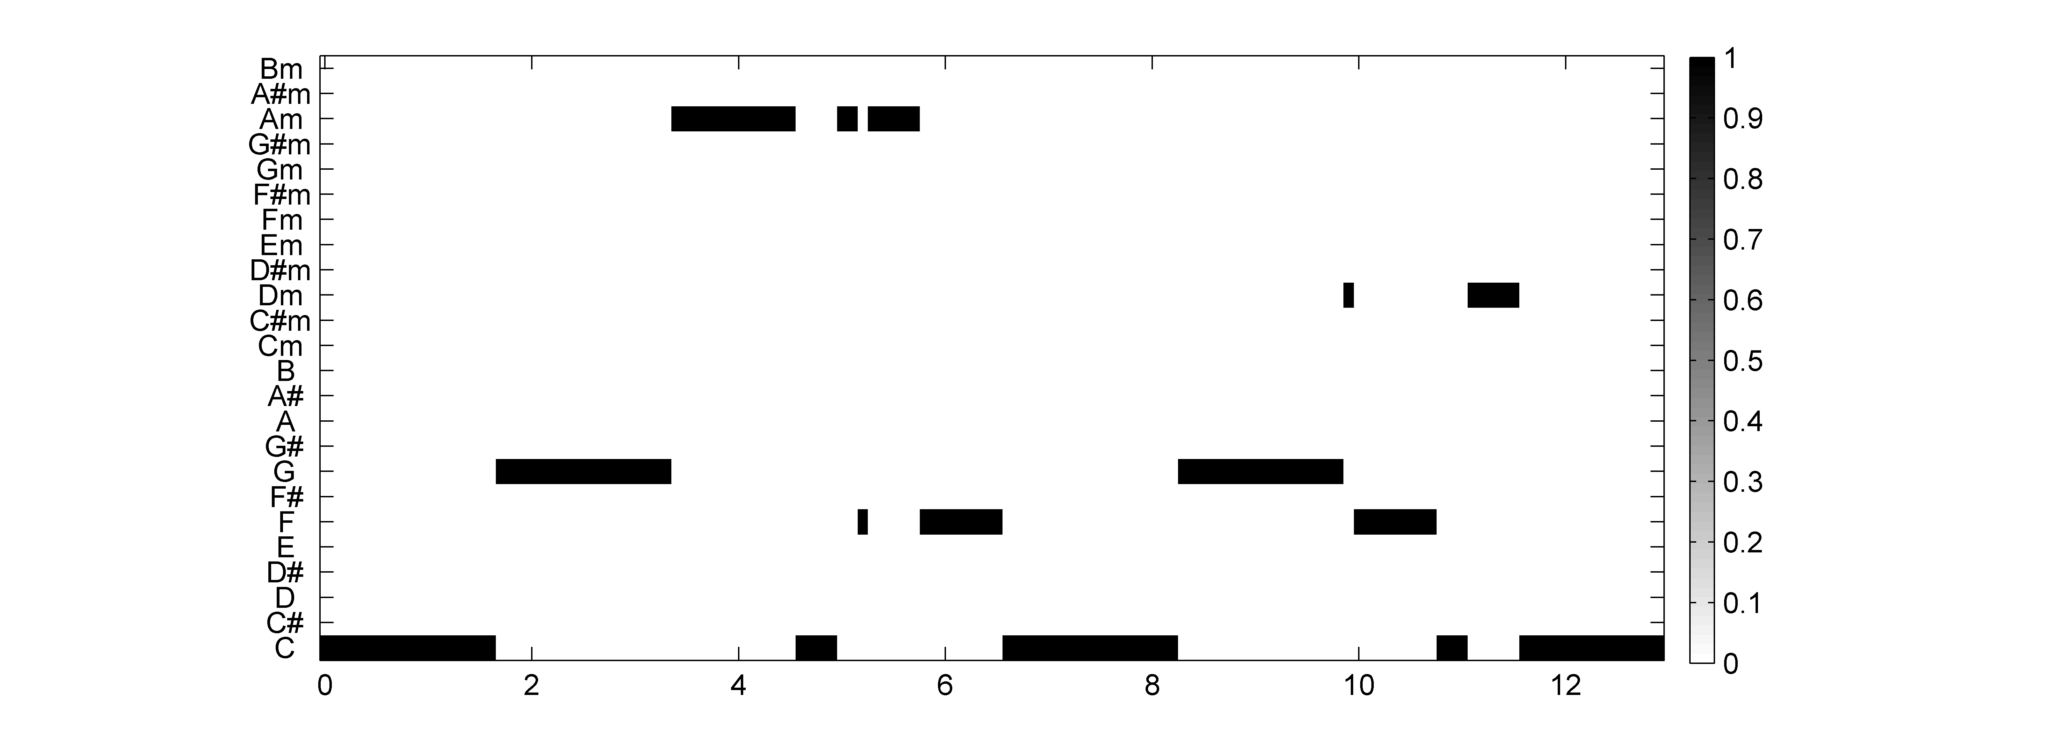
5.2 Template-Based Chord Recognition
Fig. 5.15
Chroma
Chord
Time (seconds)

Slide 24
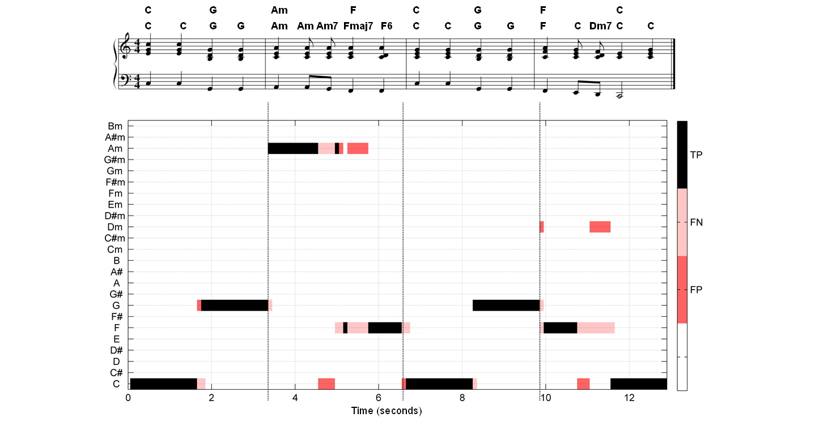
5.2 Template-Based Chord Recognition
Fig. 5.16

Slide 25
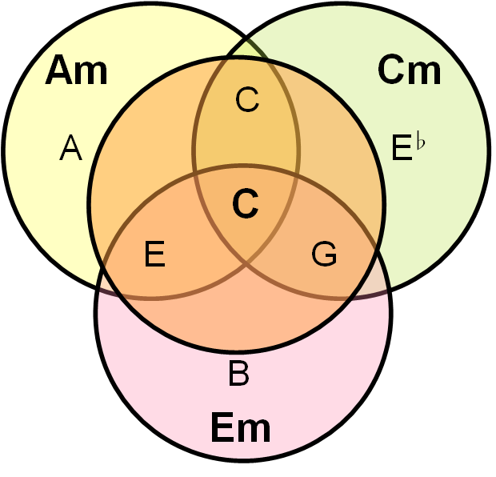
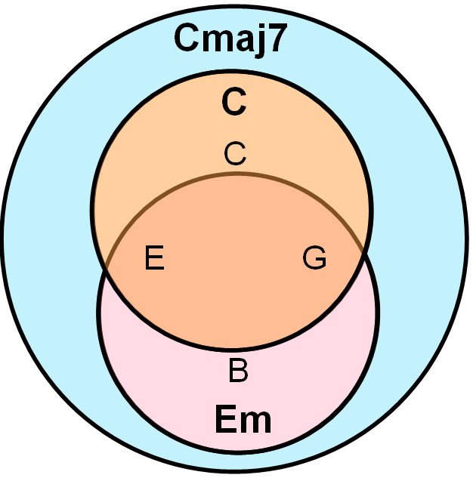
5.2 Template-Based Chord Recognition
Fig. 5.17

Slide 26
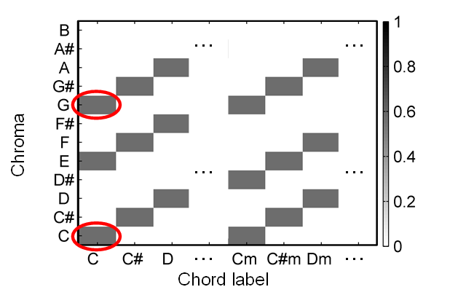
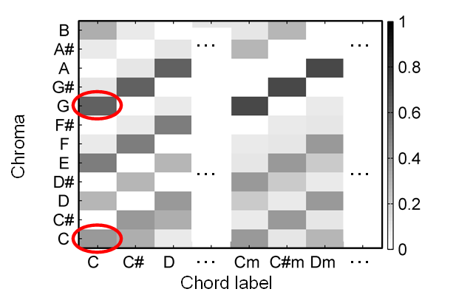
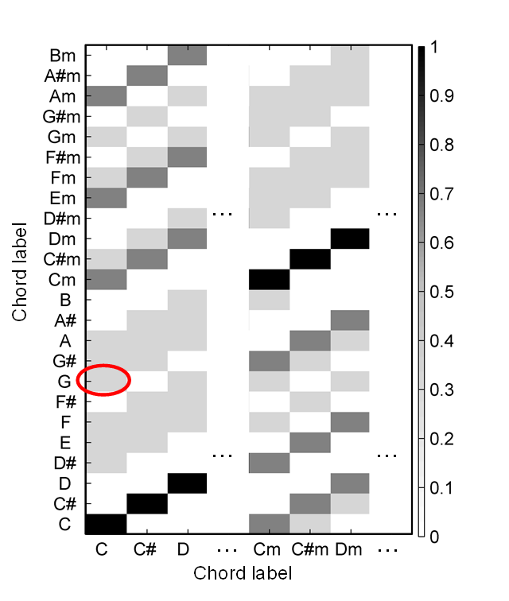
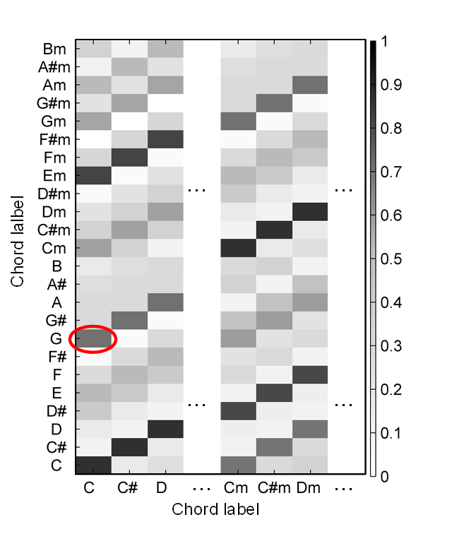
5.2 Template-Based Chord Recognition
Fig. 5.18

Slide 27
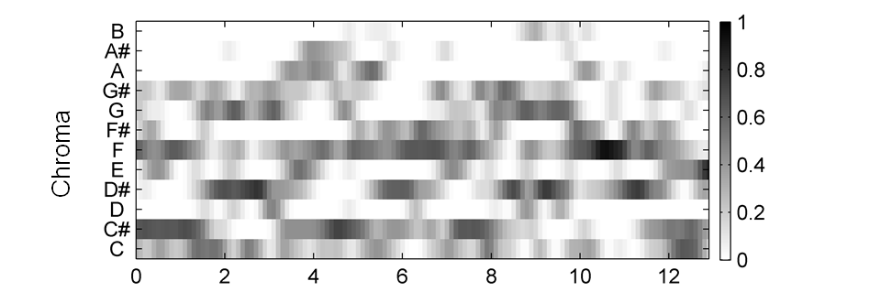
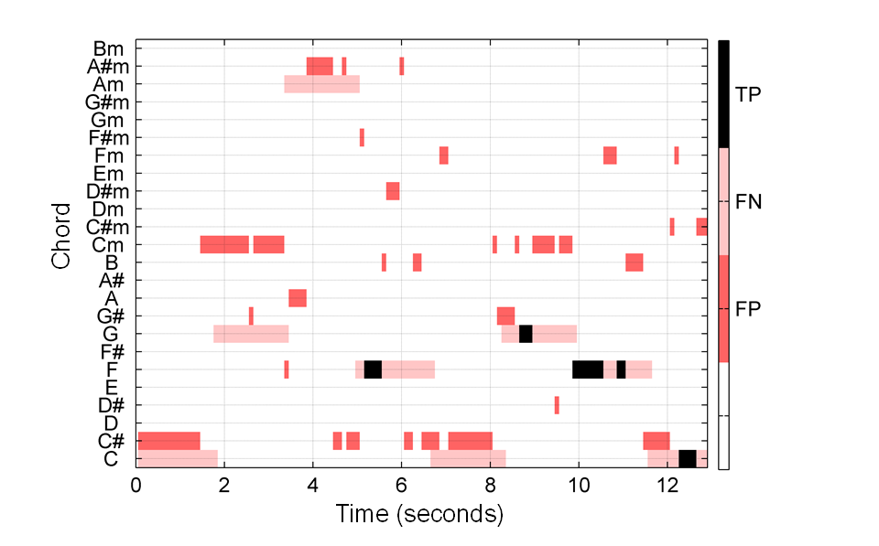
5.2 Template-Based Chord Recognition
Fig. 5.19

Slide 28
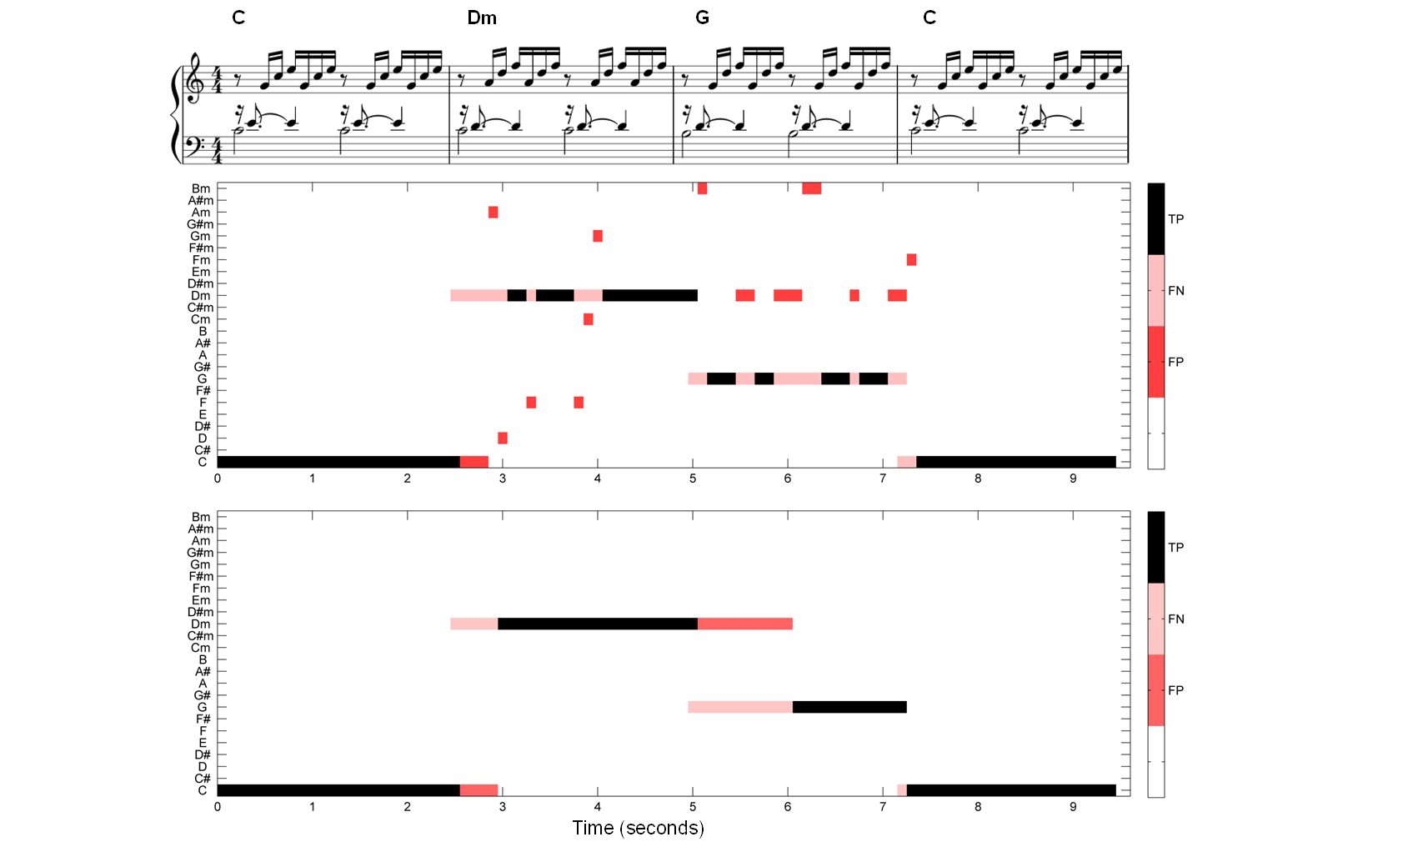
5.2 Template-Based Chord Recognition
Fig. 5.20

Slide 29
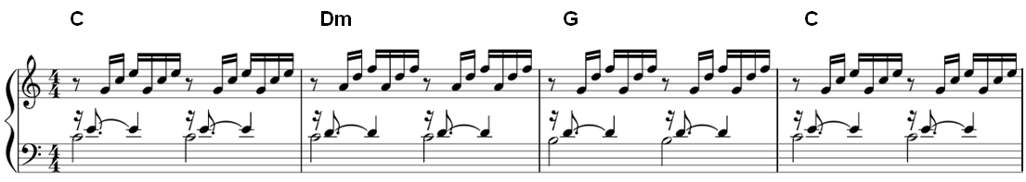
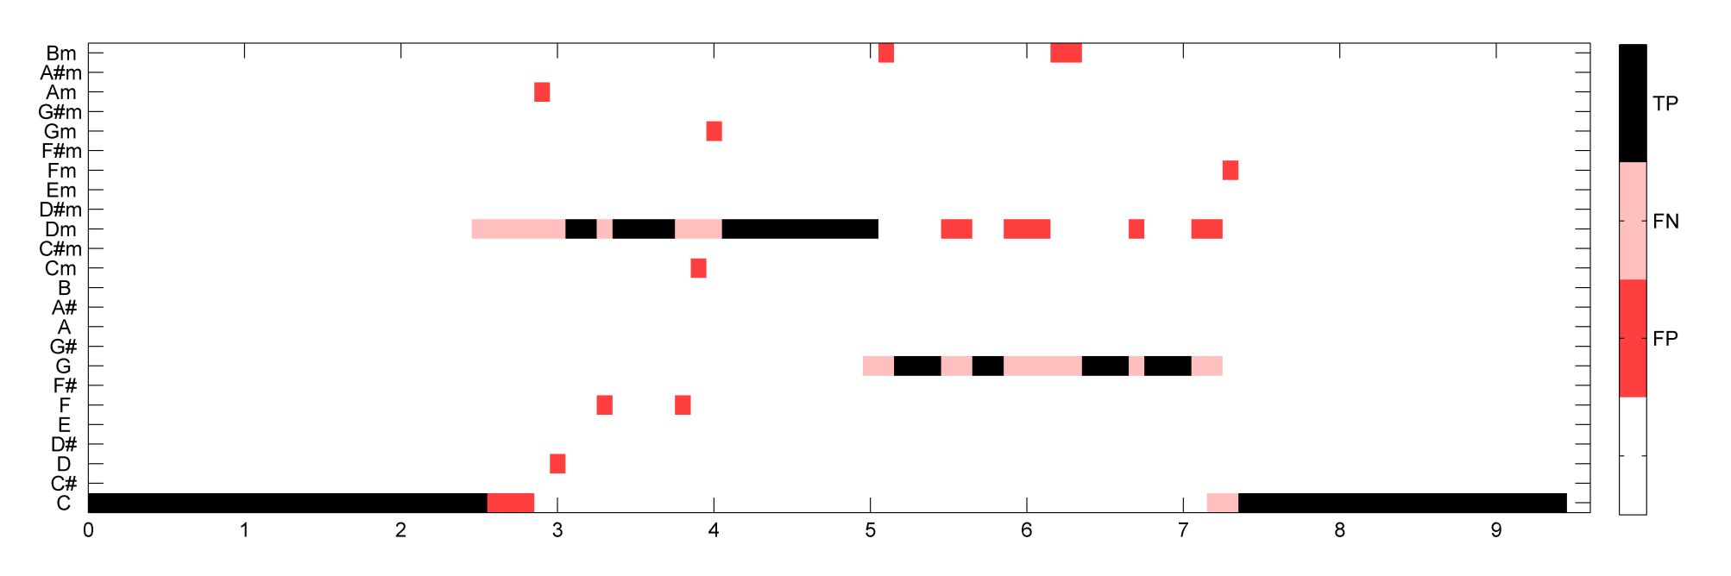
5.2 Template-Based Chord Recognition
Fig. 5.20
Time (seconds)

Slide 30
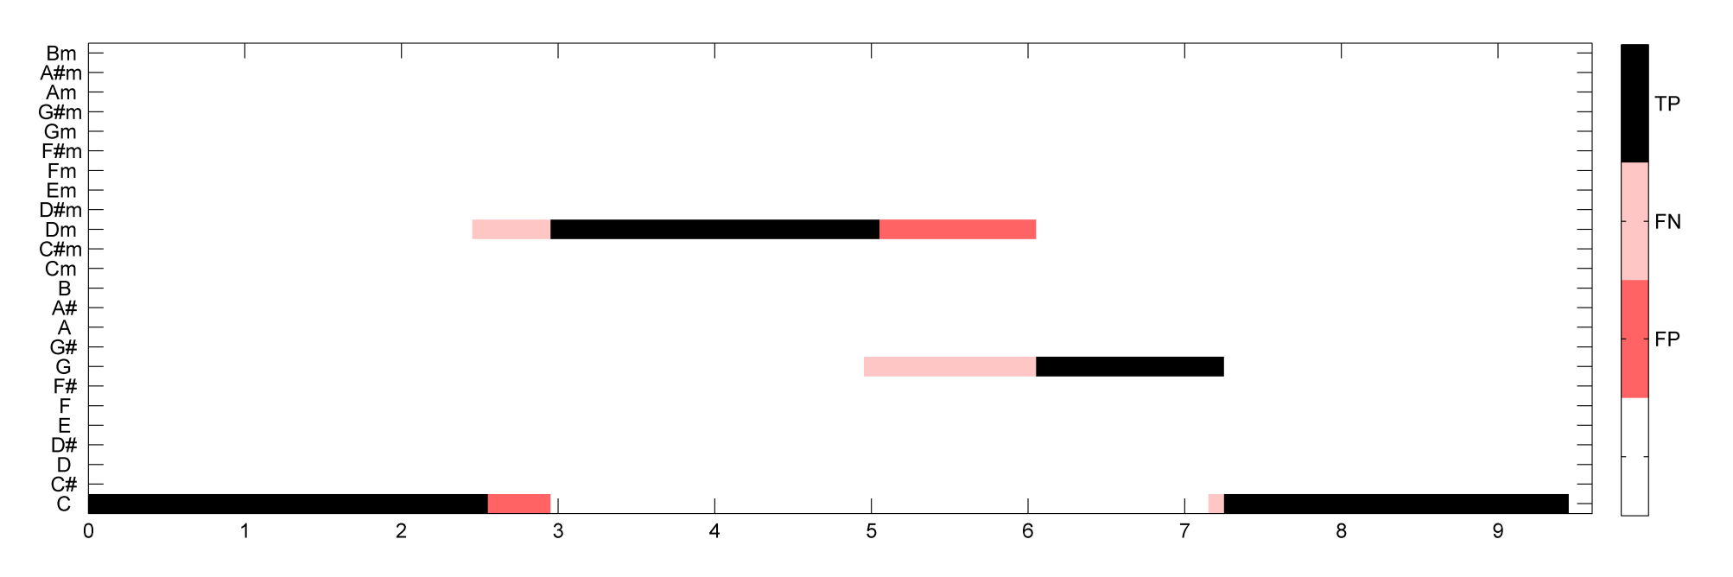
5.2 Template-Based Chord Recognition
Fig. 5.20
Time (seconds)

Slide 31
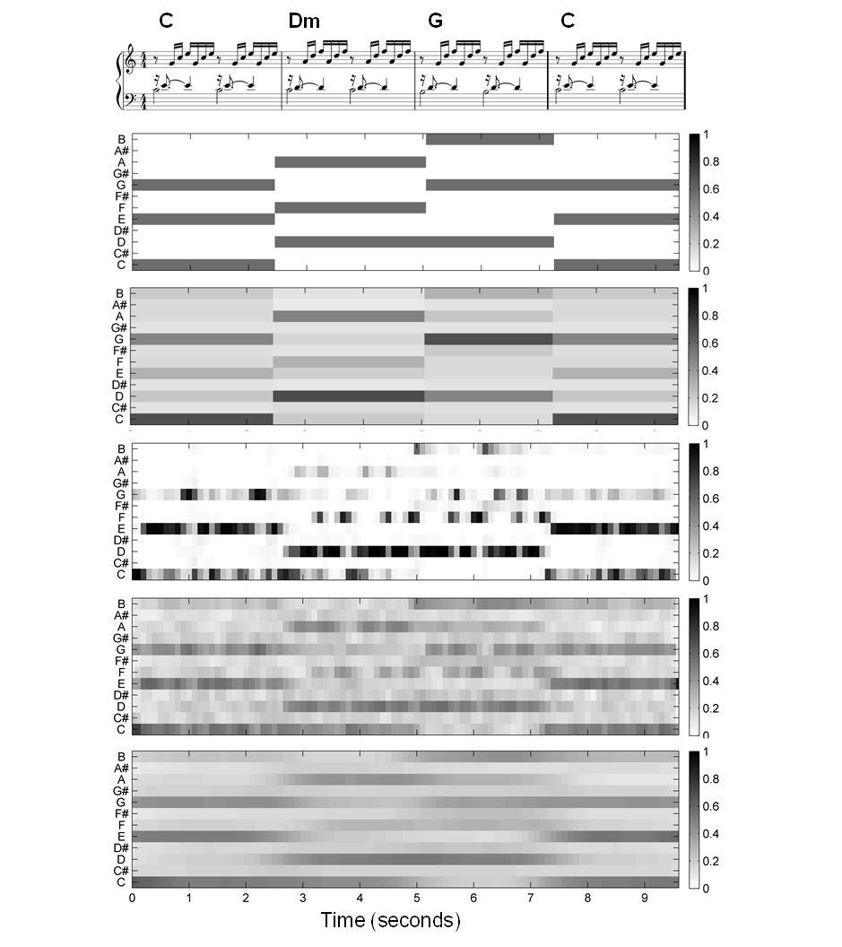
5.2 Template-Based Chord Recognition
Fig. 5.21

Slide 32
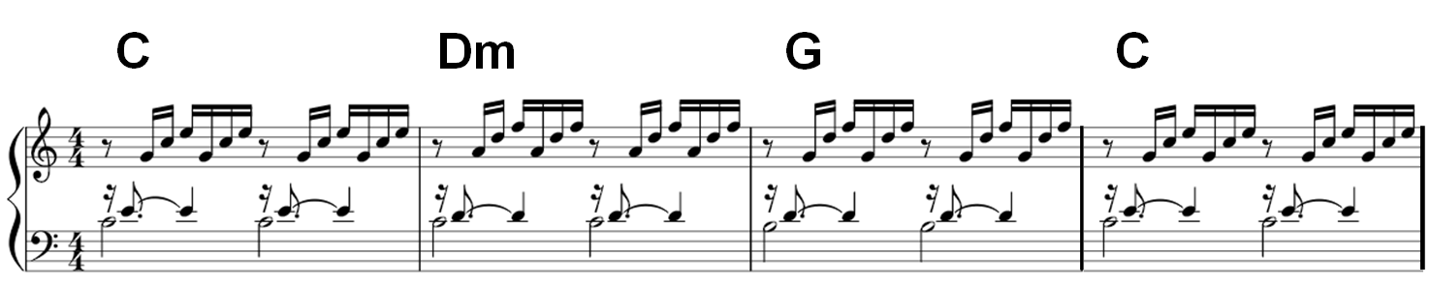
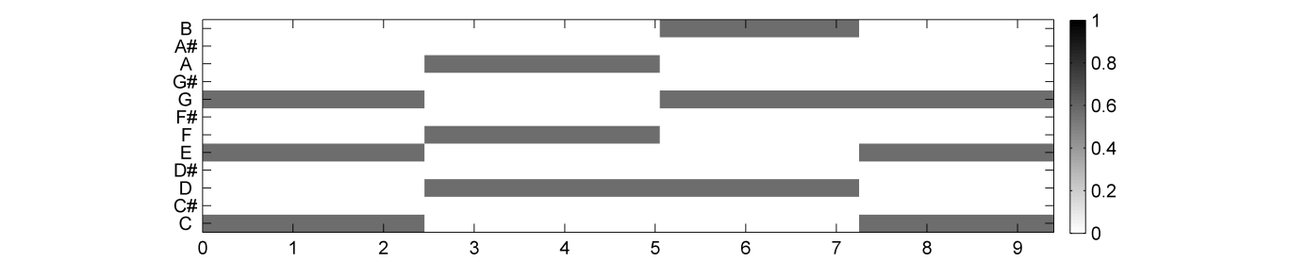
5.2 Template-Based Chord Recognition
Fig. 5.21
Time (seconds)

Slide 33
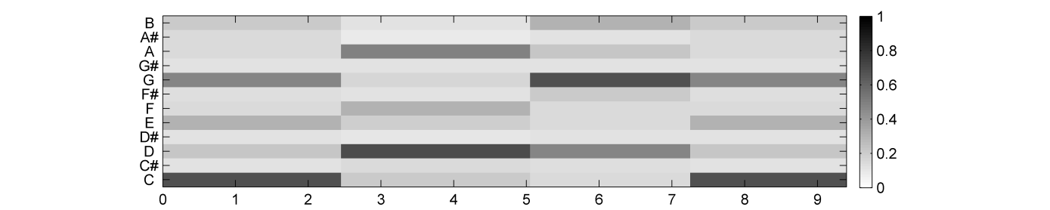
5.2 Template-Based Chord Recognition
Fig. 5.21
Time (seconds)

Slide 34
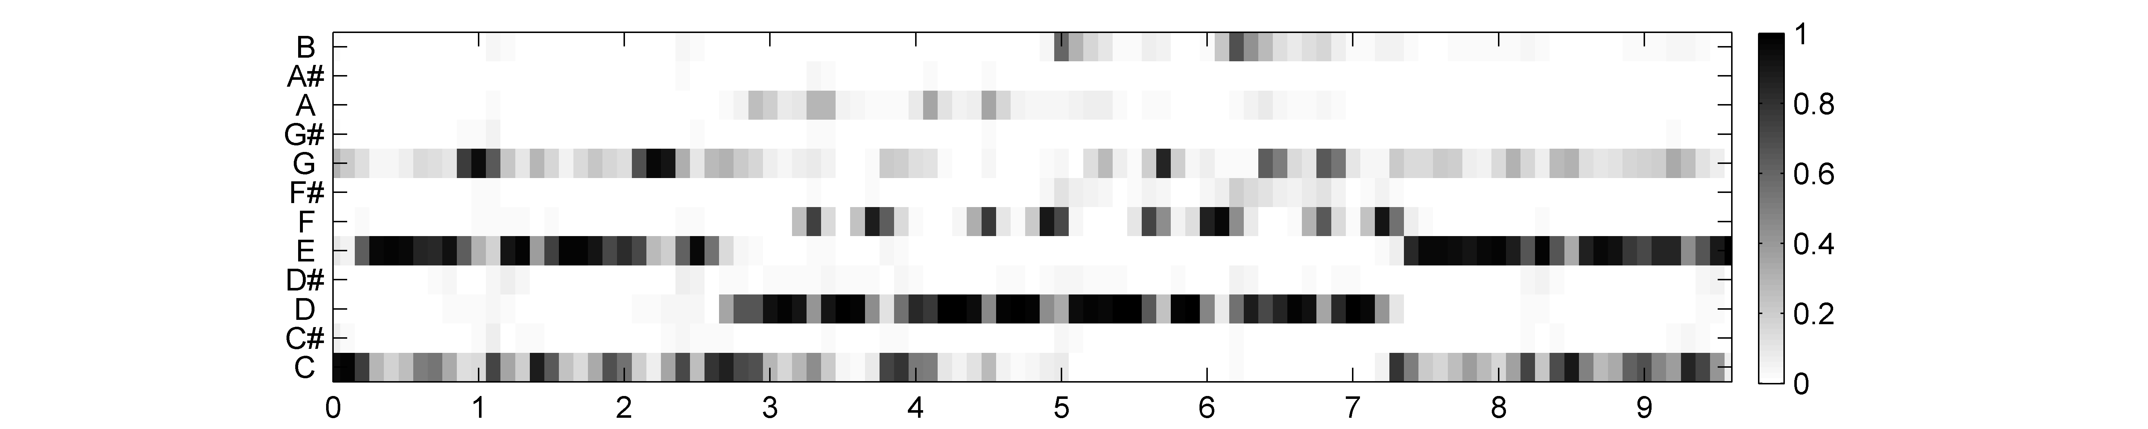
5.2 Template-Based Chord Recognition
Fig. 5.21
Time (seconds)

Slide 35

5.2 Template-Based Chord Recognition
Fig. 5.21
Time (seconds)

Slide 36

5.2 Template-Based Chord Recognition
Fig. 5.21
Time (seconds)

Slide 37

5.2 Template-Based Chord Recognition
Fig. 5.22

Slide 38

5.2 Template-Based Chord Recognition
Fig. 5.23

Slide 39


5.3 HMM-Based Chord Recognition
Fig. 5.24

Slide 40

5.3 HMM-Based Chord Recognition
Fig. 5.25

Slide 41

5.3 HMM-Based Chord Recognition
Fig. 5.25

Slide 42

5.3 HMM-Based Chord Recognition
Fig. 5.26

Slide 43

5.3 HMM-Based Chord Recognition
Table 5.1

Slide 44

5.3 HMM-Based Chord Recognition
Fig. 5.27

Slide 45

5.3 HMM-Based Chord Recognition
Table 5.2

Slide 46

5.3 HMM-Based Chord Recognition
Fig. 5.28

Slide 47

5.3 HMM-Based Chord Recognition
Fig. 5.28

Slide 48

5.3 HMM-Based Chord Recognition
Fig. 5.29

Slide 49

5.3 HMM-Based Chord Recognition
Fig. 5.30

Slide 50

5.3 HMM-Based Chord Recognition
Fig. 5.31

Slide 51

5.3 HMM-Based Chord Recognition
Fig. 5.32

Slide 52

5.4 Further Notes
Fig. 5.33

